Slide 1
Internal study group
An overview of Physical AI, necessary technologies, and AI concepts.
The complete picture, from 3D digital twins to neural networks and foundational models.

Slide 2
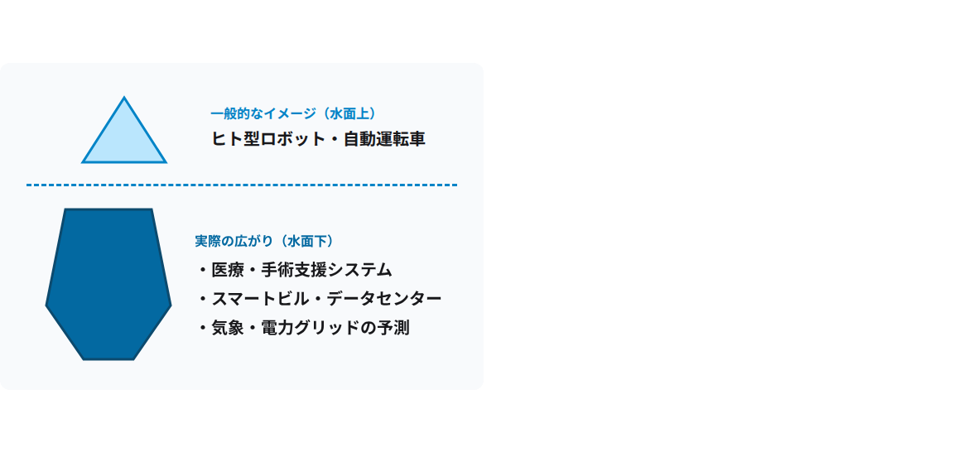
What is Physical AI? (Just the tip of the iceberg)
AI that understands the real world and moves physically
•
Definition: To perceive reality using cameras and sensors and to understand the laws of physics.
•
Medical field: Automation of surgical support and in-hospital testing.
•
Space control: Automatically adjusts air conditioning and power consumption based on temperature and airflow.
•
Infrastructure: Physical forecasts of global weather and urban energy

Slide 3

Presentation structure: Explain all technologies using one concrete example.
A project to "create a digital twin of a customer's factory and operate an AMR (Autonomous Mobile Robot) within it" was used as a common example.
Step 1
Step 2
Step 3
Building a Digital Twin
AI fundamentals and learning
Foundation model and field implementation
Virtual Recreation of Factory Space and AMR
AMR's Brain Mechanism and Training
The latest AI and Sim-to-Real on actual devices

Slide 4
Why is a simulator necessary before implementation?
Reason 01
Reason 02
Reason 03
Ensuring safety
Maintaining factory line operations
Large-scale parallel testing
Collision prevention for workers and expensive machinery
Avoiding economic losses due to line stoppages
High-speed convergence due to simultaneous operation of thousands of vehicles

Slide 5
Definition of a digital twin and the process of building a digital twin project
It's not just a simple 3D model; it reproduces the laws of physics, sensors, and the operating status of workers and other robots in real time.
•
1. 3D scanning: Measuring customer factory spaces using drones and 3D scanners.
•
2. OpenUSD: Saves 3D spatial data of factories in a common format.
•
3. URDF: Physical structure data for AMR joints and tires is placed within the factory.
•
4. ROS 2 (DDS / Zenoh): Connects the virtual AMR and control software via communication.

Slide 6
Ecosystem 1: NVIDIA Physical AI
The Role of Each Tool in Factory Digital Twin and AMR Development
Omniverse
Isaac Sim
Isaac Lab
Cosmos
OpenUSD-based foundation for 3D space and physics calculations
Virtual sensor integration into AMR and ROS 2 communication
AI training using thousands of AMRs operating simultaneously
Realistic environmental image generation using a global infrastructure model

Slide 7
Ecosystem 2: Unity Physical AI
•
Unity Engine: Execution and management of 3D factory spaces, and creation of dashboards and VR operation screens.
Unity's strengths
Lightweight operation and high operability
•
Unity Simulation Pro: URDF loading, LiDAR and other sensor simulation, ROS 2 high-speed communication
Ideal for building factory management screens (UI) and VR remote control systems.
•
ML-Agents & Sentis: AI agent training environment and direct execution of trained models

Slide 8
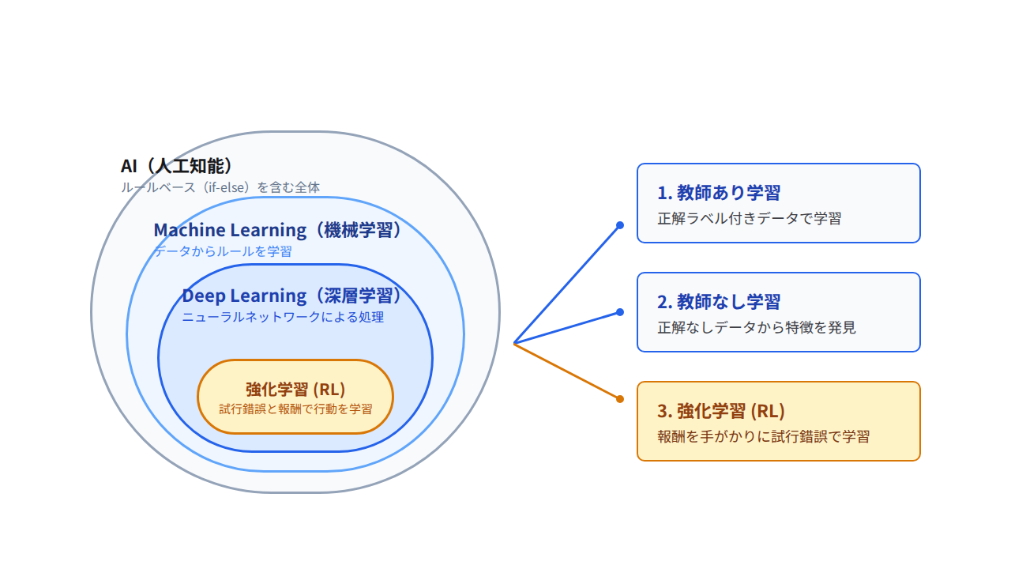
Hierarchical structure of AI, machine learning, and deep learning

Slide 9
Three specific examples of learning methods in factory AMRs
•
Supervised learning (with correct answers): The system learns from tens of thousands of factory photos labeled "people" and "forklifts" and uses a camera to recognize obstacles.
•
Unsupervised learning (no correct answers): Automatically groups "precursors to failure (abnormal patterns)" from AMR motor sound and vibration data.
•
Reinforcement learning (trial and error): Within the digital twin, rewards such as "+10 points for reaching the destination" and "-50 points for crashing into a wall" are given to learn how to drive efficiently.

Slide 10
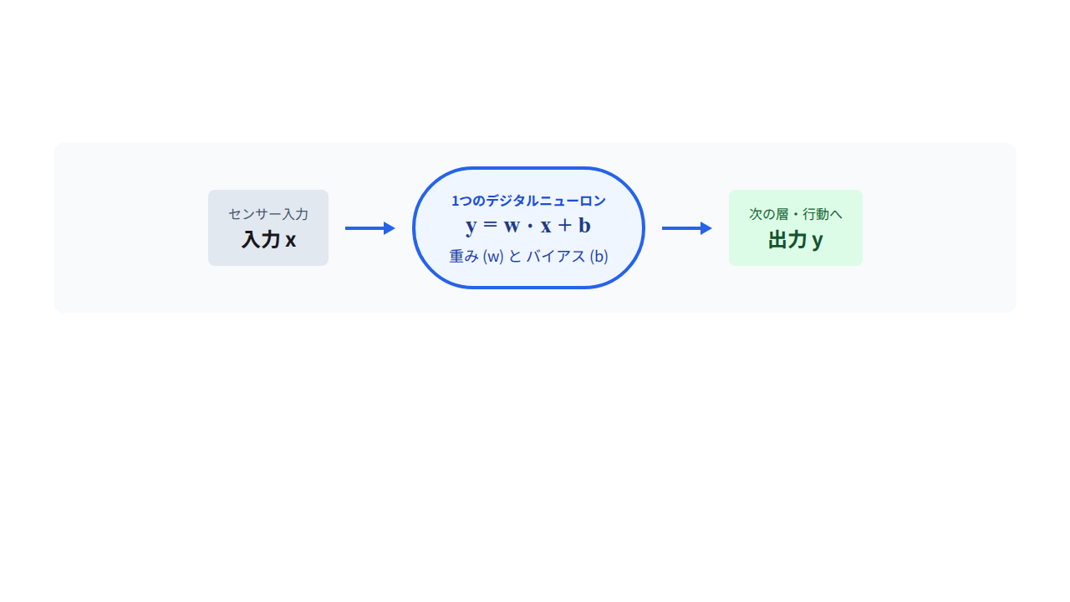
How neural networks work: A single neuron
Mimicking the nerve cells (neurons) of the human brain, each neuron is composed of two numerical values: "weight" and "bias."
Weight (w): Importance of information
Bias (b): Response threshold
The ceiling color is irrelevant, so it's set small (0.01), while the person 1m in front is important, so it's set large (0.99).
The basic summation value that determines how responsive that neuron is.

Slide 11
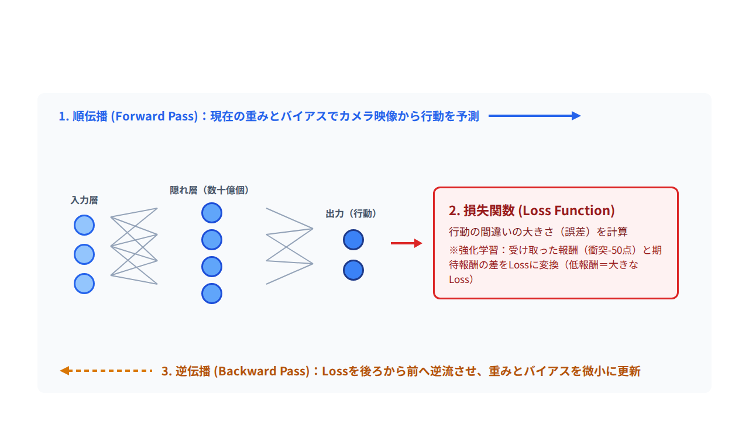
Learning loop: Forward propagation, loss function, backpropagation
The process of gradually rewriting the weights and biases of billions of neurons to converge them to the correct path.

Slide 12
Learning challenges and transfer learning/fine-tuning
Practical solutions (customer implementation flow)
Two problems that occur in learning
•
Transfer Learning: Instead of building from scratch, the foundation is pre-trained using a digital twin of a typical factory.
•
Underfitting: Insufficient training has resulted in the inability to drive straight even within the simulator.
•
Overfitting: A condition where a model memorizes the wall colors and box locations of a training factory, and then becomes unable to move when the lighting changes in a real factory.
•
Fine-tuning: Final weight adjustments are made using small amounts of customer-specific factory-specific data (such as package shape and floor color) to build the system quickly.

Slide 13
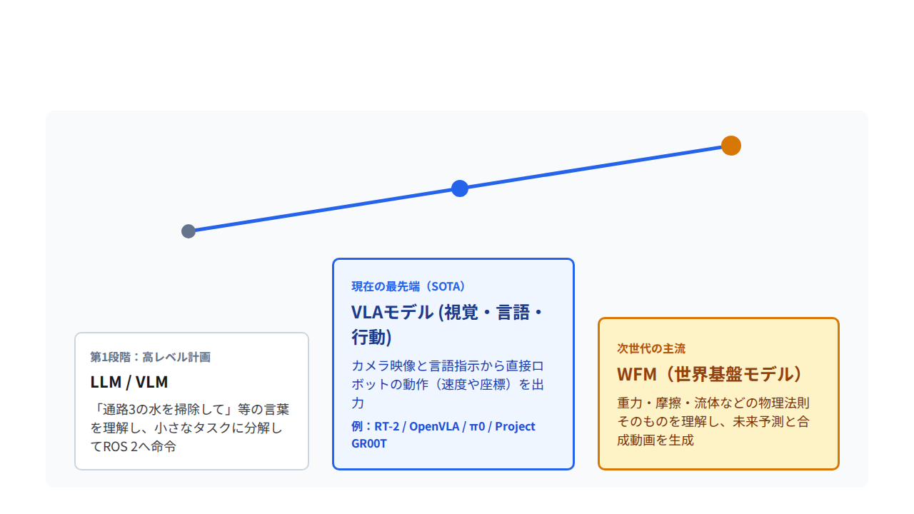
Foundational models for physical AI: Evolutionary trends
The shift from small AIs for individual tasks to one large, general-purpose "robot brain."

Slide 14
World Foundation Model (WFM) and Synthetic Video Generation
An AI that learns from tens of millions of hours of real-world video to understand the "physical rules of the world," such as gravity, friction, and the movement of objects.
•
1. Predicting the future: Before taking action, mentally simulate whether pushing this load will cause it to collapse.
•
2. Generating Synthetic Videos (NVIDIA Cosmos): Automatically generates realistic training videos from simple 3D factory videos, including scenarios like "rainy days," "dark nights," and "dirty floors."
•
Unlimited expansion of training data: Create a large amount of diverse environmental data without actually photographing in a factory.

Slide 16
summary
Understanding the overall picture and toolset of the Physical AI domain
By sharing fundamental knowledge about "what tools and AI technologies are available," we aim to create a system where new projects can be smoothly launched by selecting the most suitable technologies.
Thank you for your attention. (Question and Answer Session)

